Slide 1

Java course
-7-

Slide 2
7.Spring and spring mvc

Slide 3

What is a Spring?
The Spring Framework is an application framework and inversion of control container for the JavaEE platform.

Slide 4
How Spring works?
Spring basically consists of 2 main core functions/technologies:
Dependency Injection (DI)
The Inversion of Control (IoC) is a design principle in which the flow of control of a system is inverted. It’s a general concept, where the dependency injection is one concrete example of it.
The dependency injection separates an object from its dependencies, so we can decide which dependencies to be injected during the run time.
Aspect Oriented Programming (AOP)
It allows the separation of cross-cutting concerns from the business logic.
The cross-cutting concerns are features that span across different parts of the application and affects the entire application. Examples → logging, declarative transactions, security, caching, etc.

Slide 5
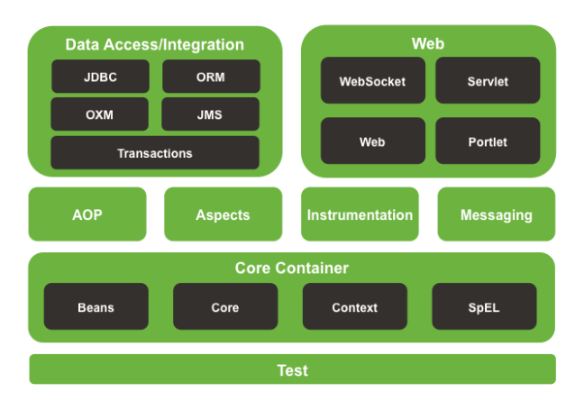
Spring Architecture

Slide 6
Core Container
It’s used for creating beans and manage beans dependencies.
The Core and Bean modules provide the fundamental parts of the framework, including the IoC and Dependency Injection features.
The Bean module provides BeanFactory, which is a sophisticated implementation of the factory pattern. It decouples the configuration and specification of dependencies from the actual program logic.
The Context module builds on the Core and Beans modules. It is a means to access any objects defined and configured.
The SpEL module provides a powerful expression language for querying and manipulating objects during the runtime.

Slide 7
Data Access
It’s used to communicate with the database.
JDBC: Provides a JDBC-abstraction layer that removes the need for JDBC related coding.
ORM: Provides an integration layers for popular object-relational mapping APIs, including JPA, JDO, Hibernate, and iBatis.
OXM: Provides an abstraction layer that supports Object/XML mapping implementations.
The Java Messaging Service (JMS): Contains features for producing and consuming messages (emails).
Transaction: It supports transaction management for classes.

Slide 8
Web Modules
It’s the home of Sring MVC framework. We can integrate other technologies like JSF.
Web: Provides basic web-oriented integration features such as multipart file upload functionality and the initialization of the IoC container using Servlet listeners and a web-oriented application context.
Web-MVC: Contains Spring’s Model-View-Controller (MVC) and REST Web Services implementation for web applications.
Web-Sockets: Provides support for WebSocket-based, two-way communication between the client and the server in web applications.
Web-Portlet: Provides the MVC implementation to be used in a portlet environment and mirrors the functionality of Web-MVC module.

Slide 9
AOP and Instrumentation
AOP: Provides an aspect-oriented programming implementation allowing you to separate the cross-cutting concerns from the business logic (as explained before).
Aspects: It’s a separate module provides integration with AspectJ.
Instrumentation: Provides support to class instrumentation support and classloader implementations.

Slide 10
Let`s start coding ☺
As we are used New->Project->Dynamic web project and convert it to maven
Editing pom.xml
Add dependencies :
-commons-logging
-org.springframework. spring-webmvc
-org.springframework. spring-context
-org.springframework. spring-aop
-org.springframework. spring-web
- org.springframework. Jstl and jstl-api

Slide 11
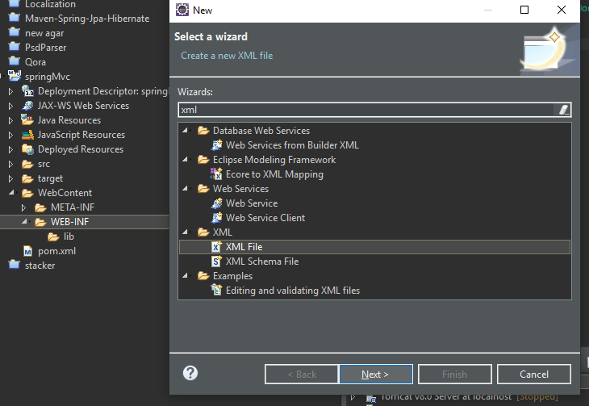
Create new Spring Configuration Bean

Slide 12
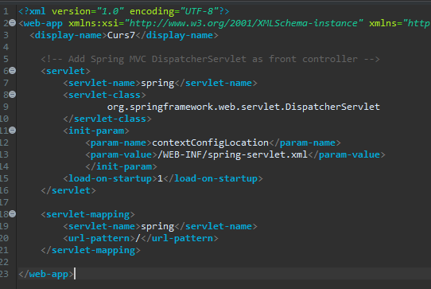
Edit web.xml

Slide 13
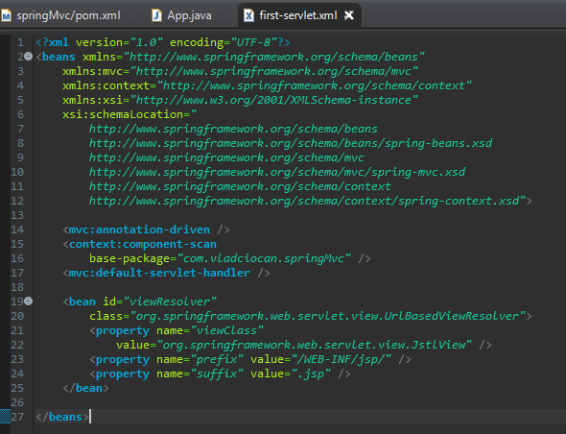
Create new Spring Configuration Bean

Slide 14
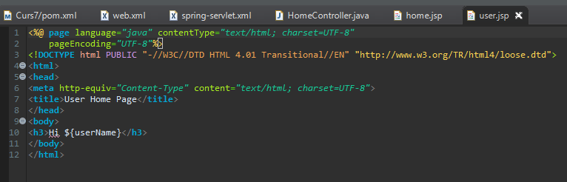
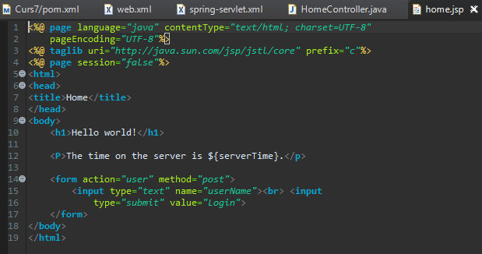
Create 2 views

Slide 15
Create new Spring Configuration Bean

Slide 16
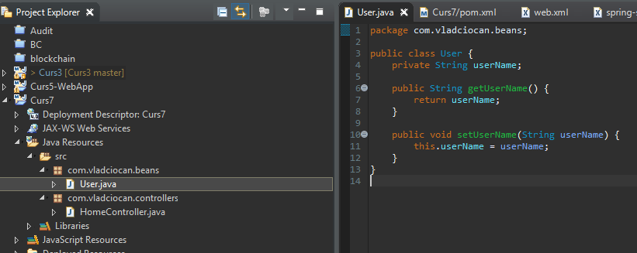
Create an entity

Slide 17
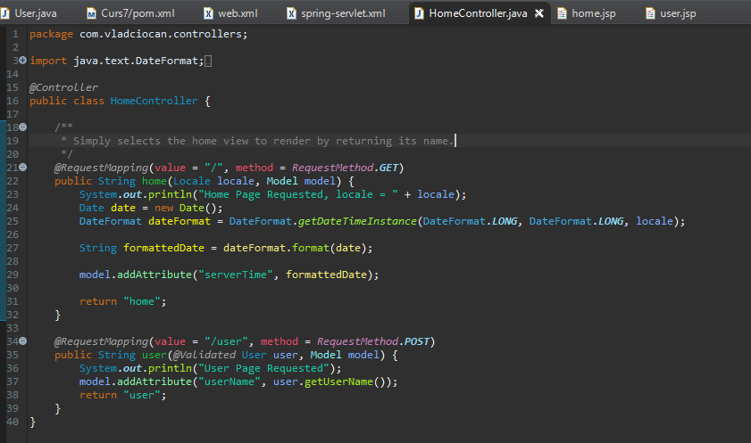
Create an controller

Slide 18
Finishing touch
-Update maven project
-Run on server

Slide 19
That`s it for today
Session review
-You learned Spring MVC
-You learned more about JSP
-You know how API`s work
GOOD JOB! ☺

